Slide 1
Topic: Piece Wise Graphs
EQ: What are piece wise graphs and how do we read them?
Ms. Latham

Slide 2
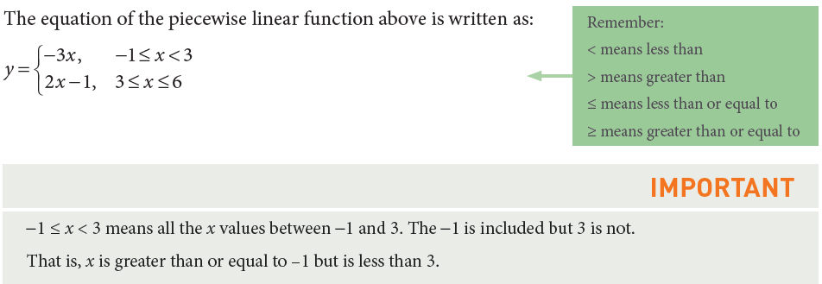
Topic: Piece Wise Graphs
EQ: What are they and how do we read them?
What is a piece wise graph?
A combination of two or more straight lines. It is made up of separate ‘pieces’ that each have a different gradient. The second line segment starts where the first line segment finishes

Slide 3
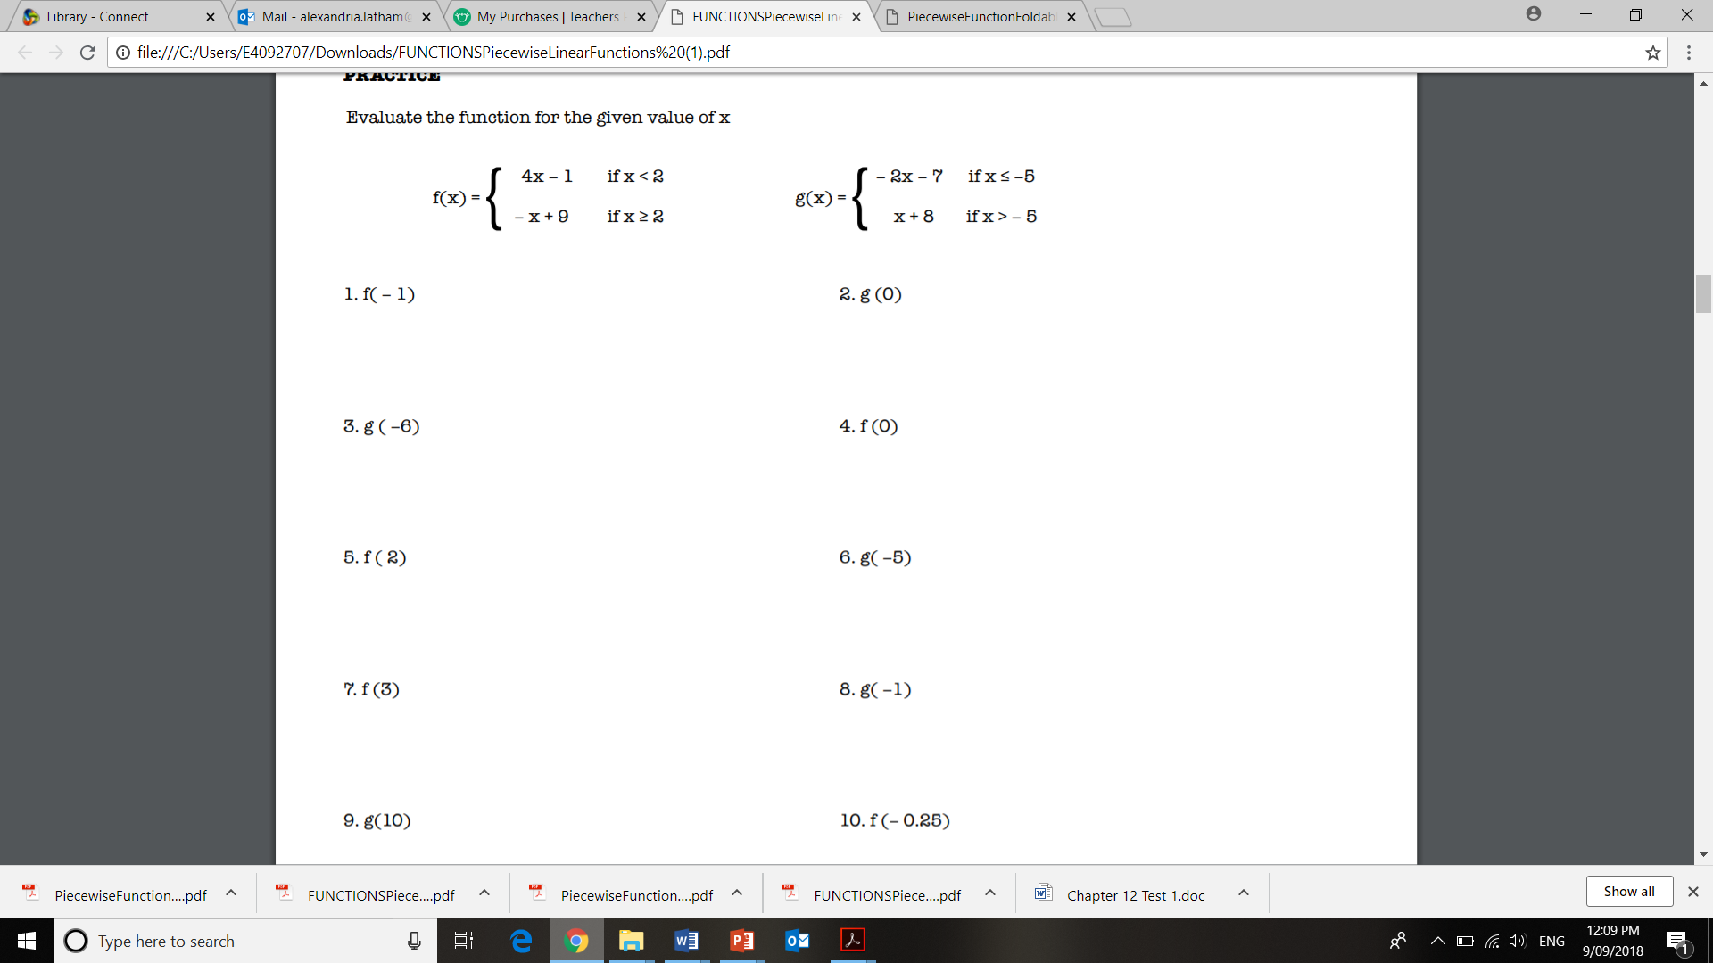

Slide 4
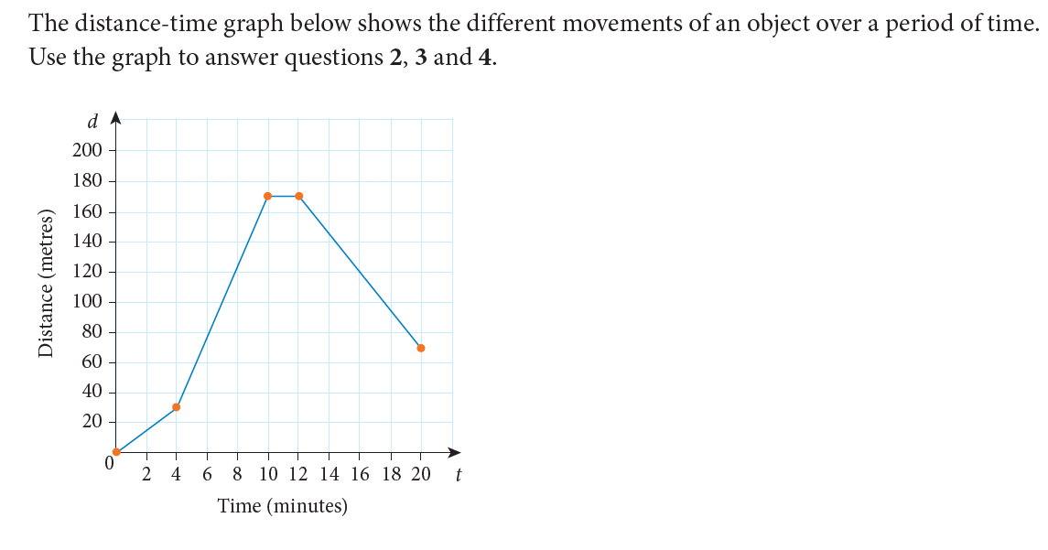
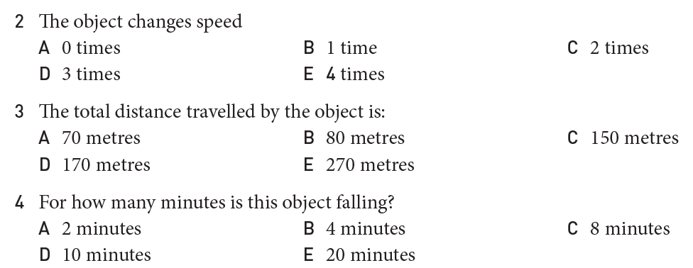

Slide 5
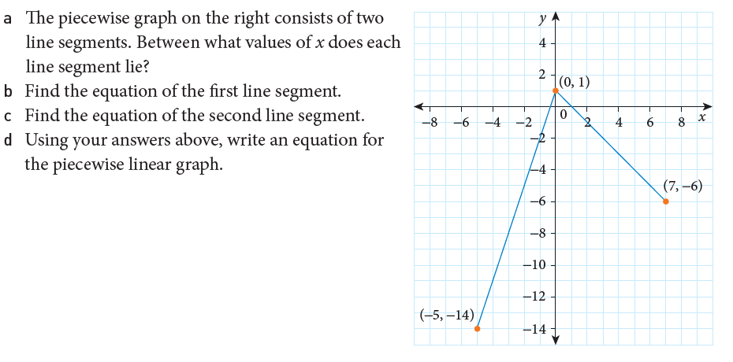

Slide 6
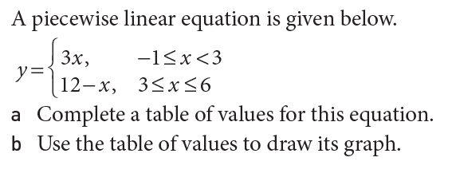
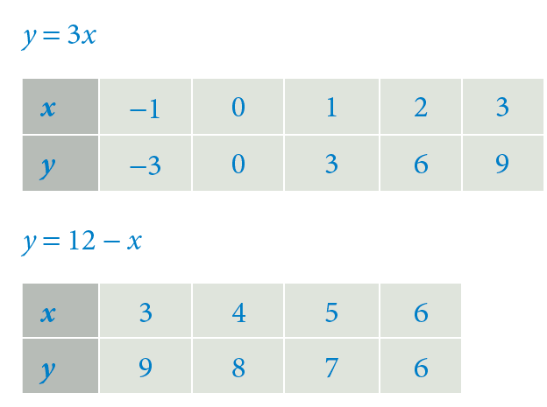
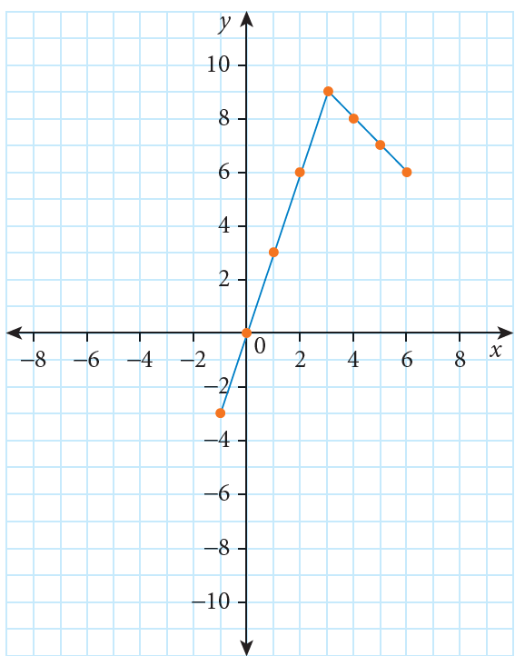
Steps to Draw a Piece- Wise Function
Step 1. Identify how many line segments
There will be two line segments.
Step 2. Complete a table of values for each of the segments
Step 3: Plot the points
The process of creating a table of value can be very time consuming. You can define the critical points (end points) and plot them and connect.

